Slide 1
Central Limit Theorem
Presenter - Huzefa Lohawala

Slide 2
Topics to Cover
Background of the terms used in formulating the theorem
Probability Distributions
What is Central Limit Theorem
Normal Distribution
Significance of Central Limit Theorem
Sampling from a Population
Statistical Significance
Demonstration in Python
Mean and STD of a Sample
Practical Significance

Slide 3

Probability Distribution
Let's start with a discreet random experiment
The probablity of each random outcome is listed below
Probability for discreet events x is defined as:
Outcome | Probability
2 | 1/36
3 | 2/36
4 | 3/36
5 | 4/36
6 | 5/36
7 | 6/36
8 | 5/36
9 | 4/36
10 | 3/36
11 | 2/36
12 | 1/36
Say we are rolling a pair of “Fair” dice and our experiment is to calculate the sum of numbers appearing on the dice.
We call this experiment discreet because we can list down all the possible outcomes for this experiment and random because we are using fair dice in this experiment and thus we cannot predict the outcome.

Slide 4
If we were to represent this distribution on graph, it would look like this:
We call such a probability distribution a Discreet Non-Uniform Probability Distribution
“Discreet” because we can list out all the individual outcomes of this event
And “non-uniform” because the probablities of each event is different.
If we sum up the individual probabilities of all the random outcomes, the final result will always be equal to 1
Which is no surprise as total probability of any experiment will always be equal to 1.

Slide 5
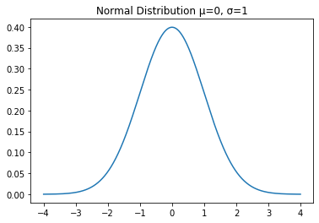
But what if our random variable can take infinite number of values or in other words, what if the outcomes of our experiment can be any value on a real number line?
In such cases we usually plot Probabiliy Density Functions.
For example, if we are measuring heights of everyone in our family.
Events like these are called continuous events and
we cannot compute probabilities of each individual outcome like we did in the case of discreet event.
Rather than giving us the exact probability of a random event, a PDF gives us the probability of that event falling within a range of values.

Slide 6
So, going back to the example of measuring the heights of our family members.
Examples of continuous PDF:
Uniform Distribution
Normal/ Gaussian Distribution
Poisson Distribution
If f(x) denotes the probability density function of heights of our family members, then the probability that a member has a height between 5.5 ft and 6.5 ft is given by:
The total area under the a PDF is always equal to 1. i.e.

Slide 7
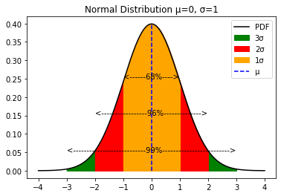
Normal Distribution
Properties of Normal Distribution
A Normal/ Gaussian Distribution is given by:
The mean, median and mode are all equal.
The curve is symmetric at the center
Approximately 68 % of the values lie within 1 σ of the mean, 96% of the values lie within 2 σ of the mean and 99 % of the values lie within 3 σ of the mean.
Here, “µ” is the mean of population, “σ” is the standard deviation of the population and “x” is any random variable in the domain of this function

Slide 8
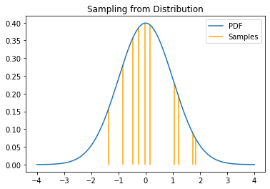
Sampling from a Population
Let's say we are performing an experiment, the outcomes of which are governed by the probabilites defined by a PDF “F”. We call the collection of all these possible values from our experiment as our “Population”
Hence, we are “Sampling” out “n” number of outcomes from our initial distribution function “F”
If we perform the above experiment “n” number of times, we'll be getting a set of outcomes X = {X1, X2, X3..., Xn}
We call this “X” as our “Sample” of the Population.

Slide 9
Mean and Standard Deviation of a Sample
Continuing from our last drawn sample “X”
Then the mean of a sample is given by:
Let's define ∑(X_{i}) as sum of all the outcomes in “X” i.e. (X1 + X2 + ... + Xn) and “n” as the total number of elements in “S”.
And the Standard Deviation is given by:
Variance is just the square of standard deviation

Slide 10
Central Limit Theorem
Now we are ready to define the Central Limit Theorem
And let
CLT states that the average/mean of many independent copies of a random variable is approximately a normal random variable.
Here, x̅_{n} is itself a random variable.
I know this definition looks confusing... So, let's break it down and understand it piece by piece.
Then the CLT states that as “n” grows, distribution of x̅_{n} converges to the Normal Distribution ~ N(µ, σ²/n)
Suppose X1, X2, ...,Xn are independent random variables with the same underlying distribution with mean “µ” and standard deviation “σ”.
Mean of the Sample Means = µ
Variance of the Sample Means = σ²/n

Slide 11
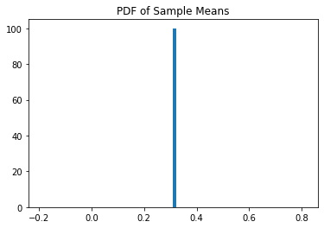
Start with any probability distribution
Draw a random sample from the distribution
Plot the PDF of the mean of the Samples

Slide 12
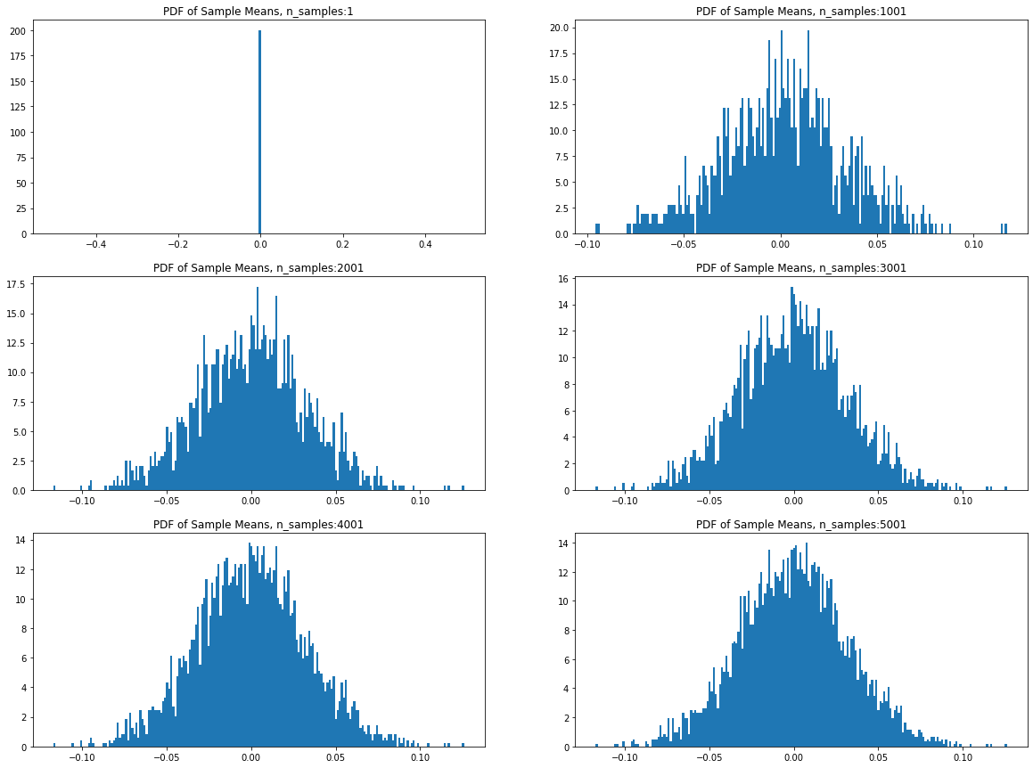
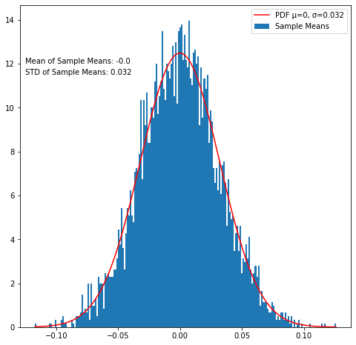
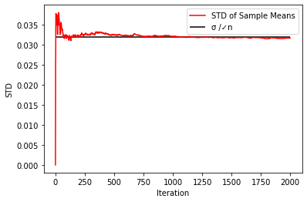
Iterate over steps 2 and 3 multiple times
Fit a Normal Distribution with mean = µ and var = σ²/n to the final plot to check the validity of the theorem. The first figure proves that the Normal Distribution N(µ, σ²/n) is a great approximation of the underlying curve of mean of samples and the second curve proves the convergence of the variance of probablity distribution curve to σ²/n

Slide 13
Significance of Central Limit Theorem
Statistical Signifiance
Practical Significance
In cases where we don't know the distribution of underlying population, we can make inferences about the mean and standard deviation of the population using the CLT. These sample means together with the population mean can be used to perform T-tests and ANOVA which can give us the statistical significance of these measurements.
Election Polls are the prime applications of Central Limit Theorem. These polls estimate the percentage of people supporting a candidate. Along with these percentages, they also give a confidence interval around their prediction which is computed using CLT.
Estimating mean of sample means and std of sample means we can contruct confidence intervals around our underlying population.
Computing confidence intervals through CLT can help us in estimating mean family income for a particular region.
If we increase the samples drawn from the population, the standard deviation of sample means will decrease. This helps us estimate the population mean much more accurately.

Slide 14
Python Demonstration

Slide 15
Thank You!!

